Slide 1
Building Rent Management System
Project Members:-------------,------------------
Course Title: RDBMS Lab
Course Code: CSSE-403
1
August 23, 2022

Slide 2
Overview :
Admin
User Mode
Owner Mode
Dependencies
Conclusion
Introduction
Objective
E-R Diagram
Site Tree
Project View
Login pages
3

Slide 3
Introduction :
A software which developed by Python using tkinter module
For make the rent system online based
Help anyone to find a rent easily
Help a owner to find a renter fastly
4

Slide 4
Objectives :
To make the building rent system easy and helpful
To decrease the suffering of searching buildings for rent
To save the time of searching building for rent
To find buildings easily even if one doesn't know the area
To know about extra facilities and opportunity of a building
To compare and find the best building easily
5

Slide 5
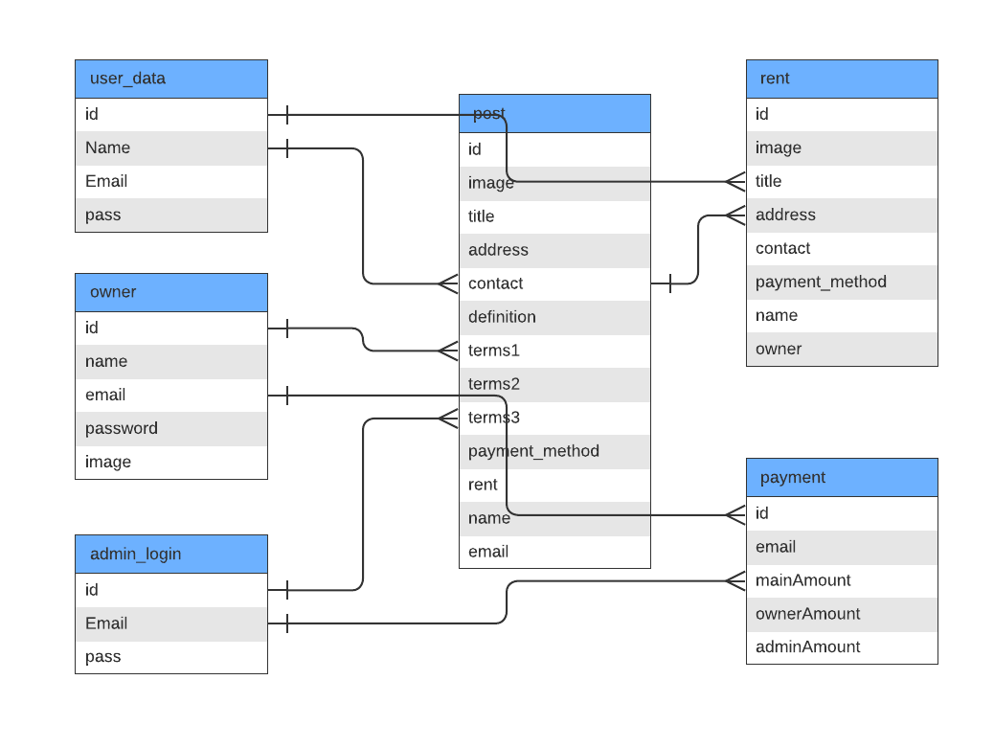
Entity Relationship Diagram:
6

Slide 6
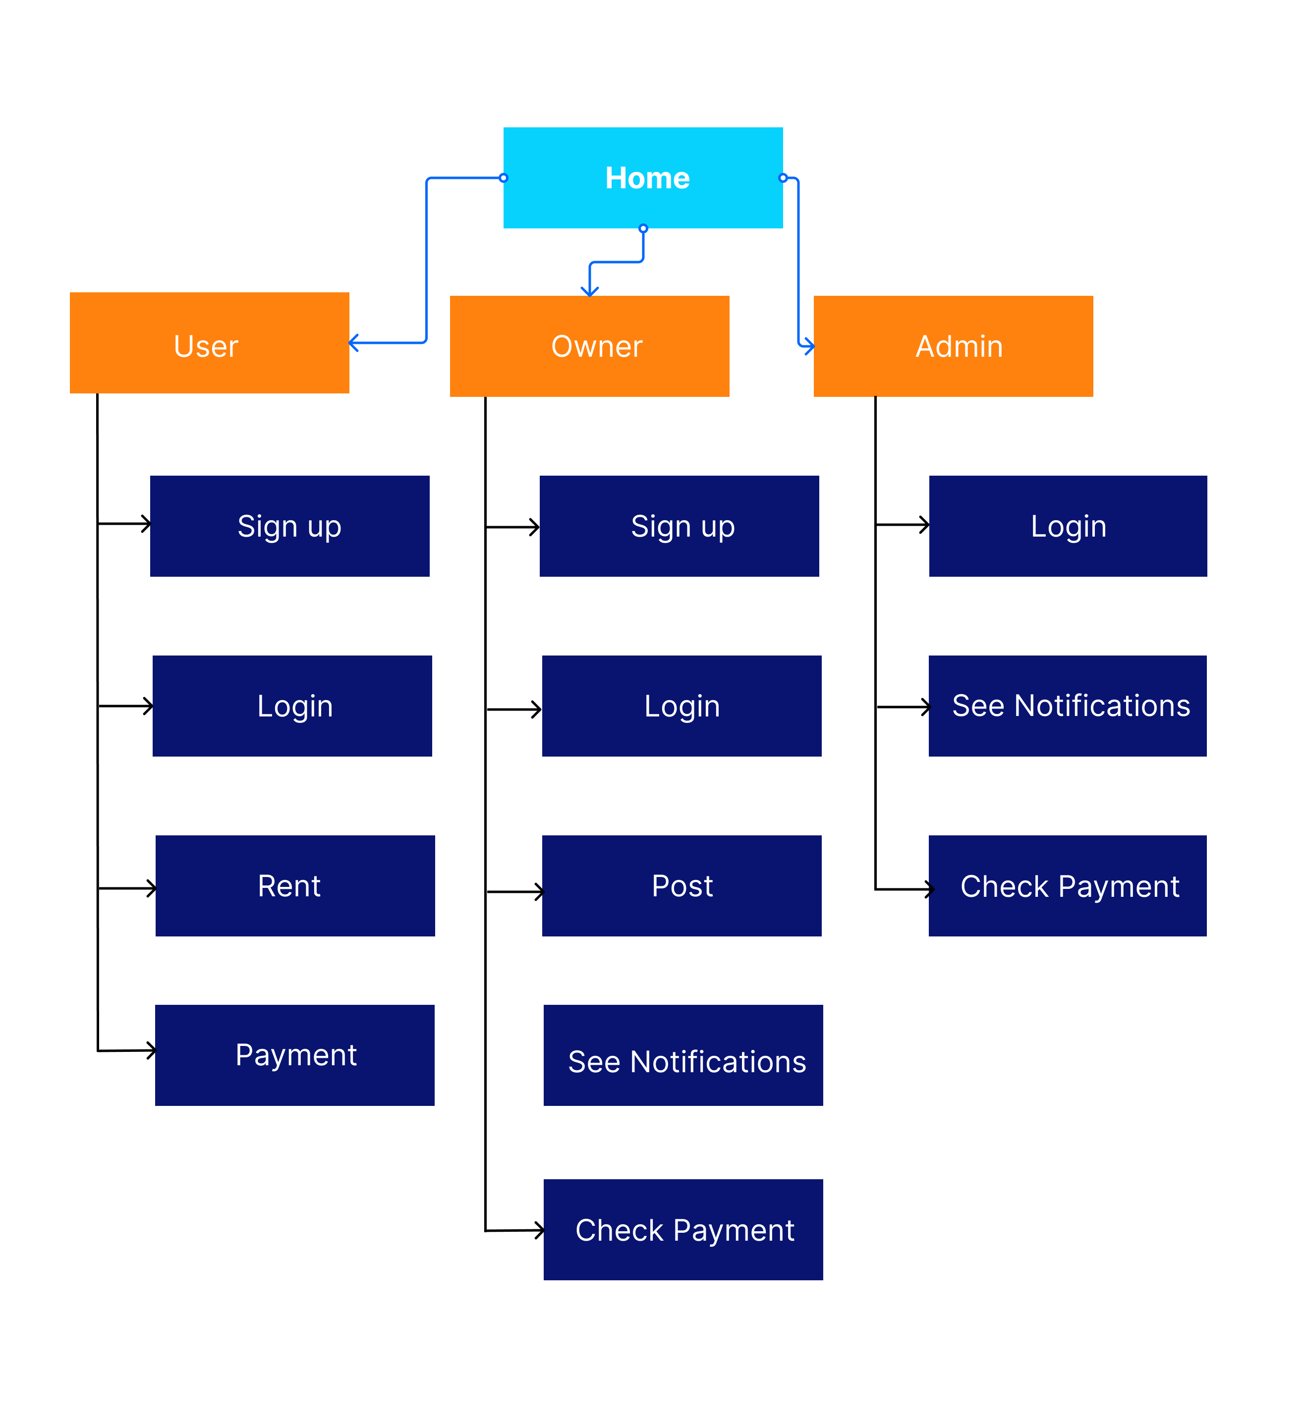
Site Tree :
The system have 3 actors.
1.Admin
2.Owner
3.User
Each actors have unique role and different interface.
7

Slide 7
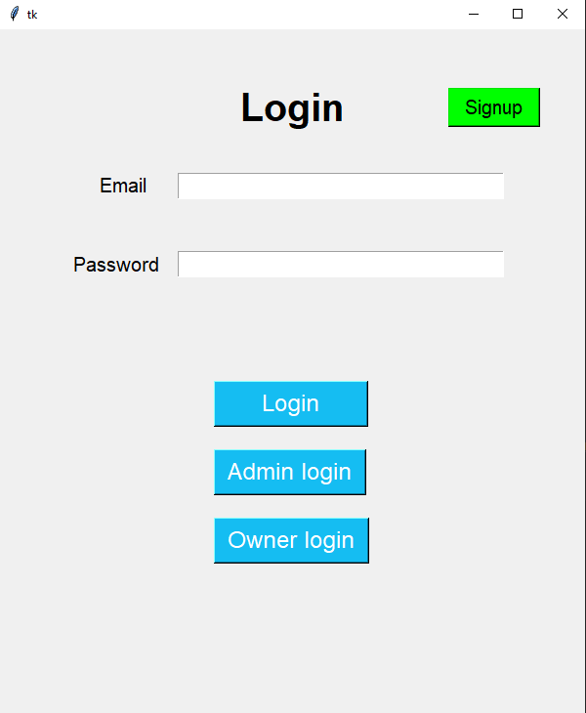
Project View
If there’s no account then one can signup
User will fill the form and click here to login
Admin will fill the form and click here to login
Owner will fill the form and click here to login
8
Login page

Slide 8
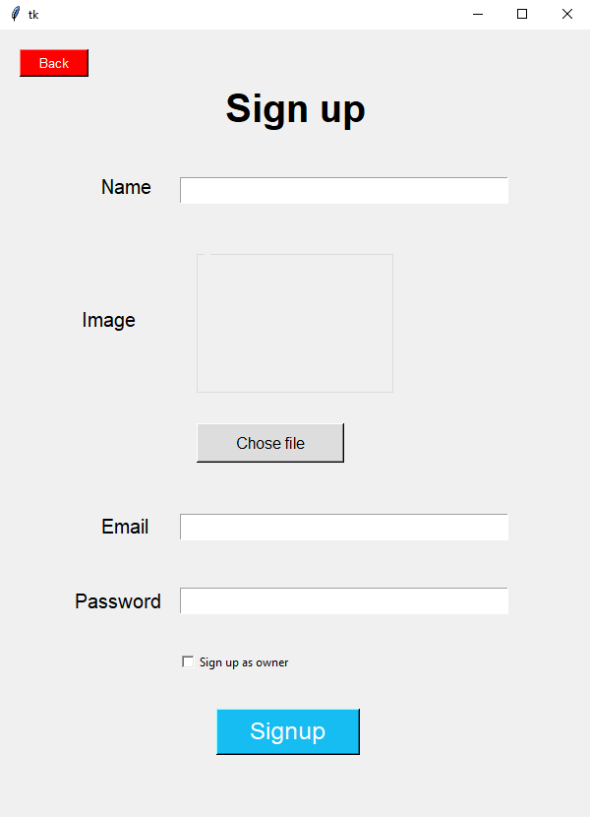
Sign up
9
Sign up page

Slide 9
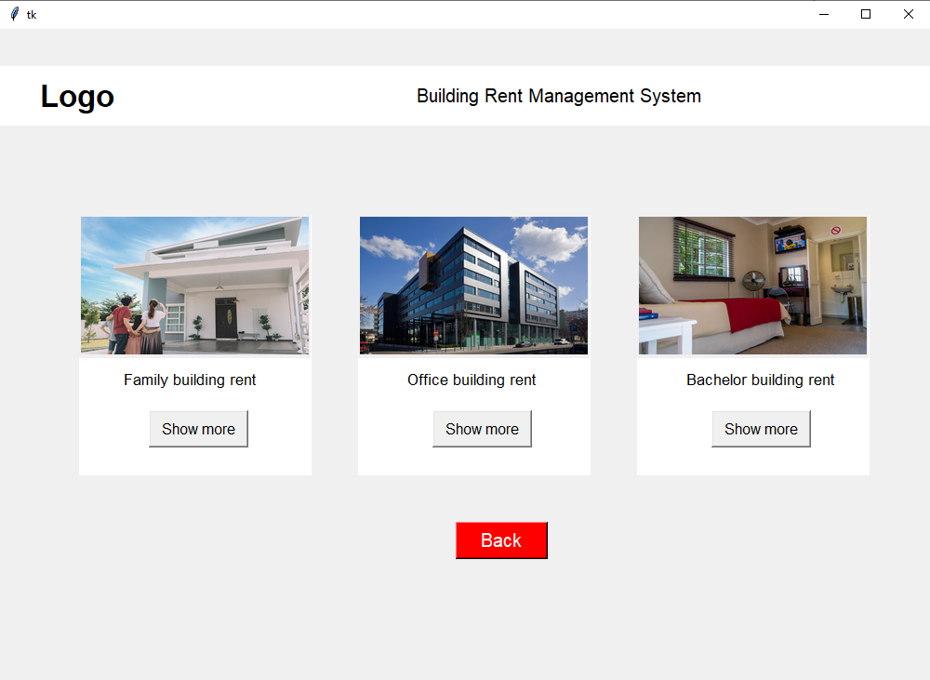
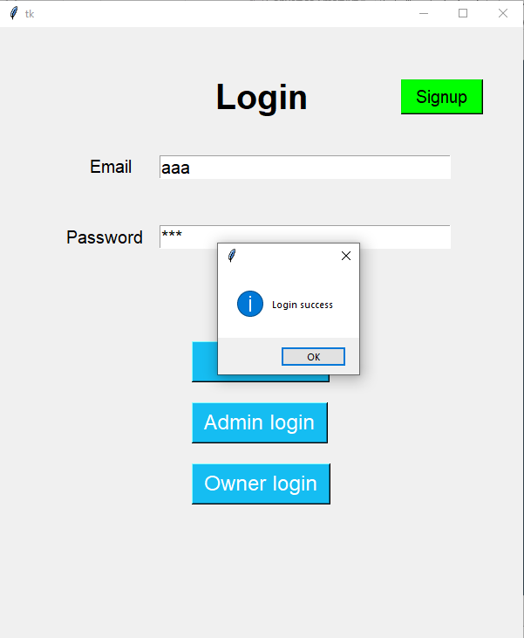
User Mode
10
User show after login

Slide 10
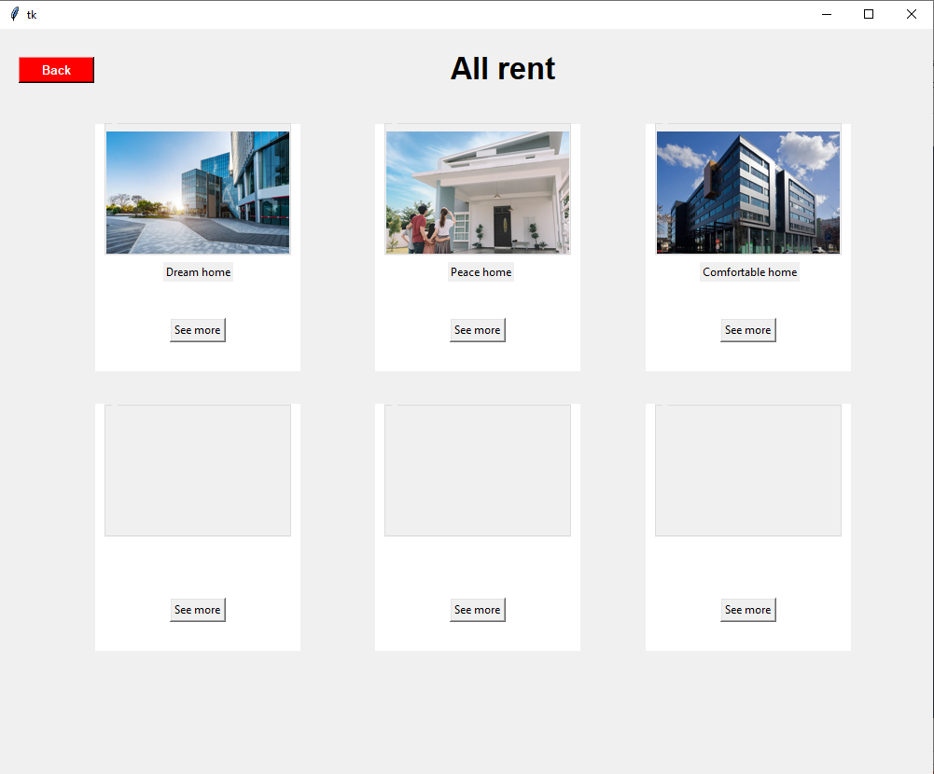
User Mode
11
Categories after login

Slide 11
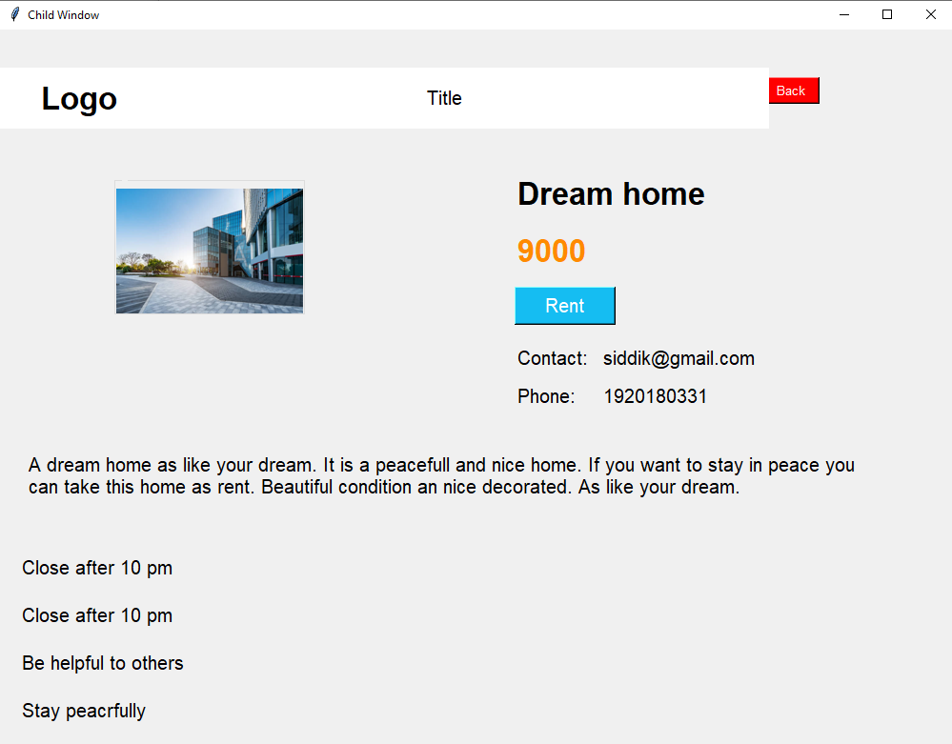
Back
12
After clicking see more

Slide 12
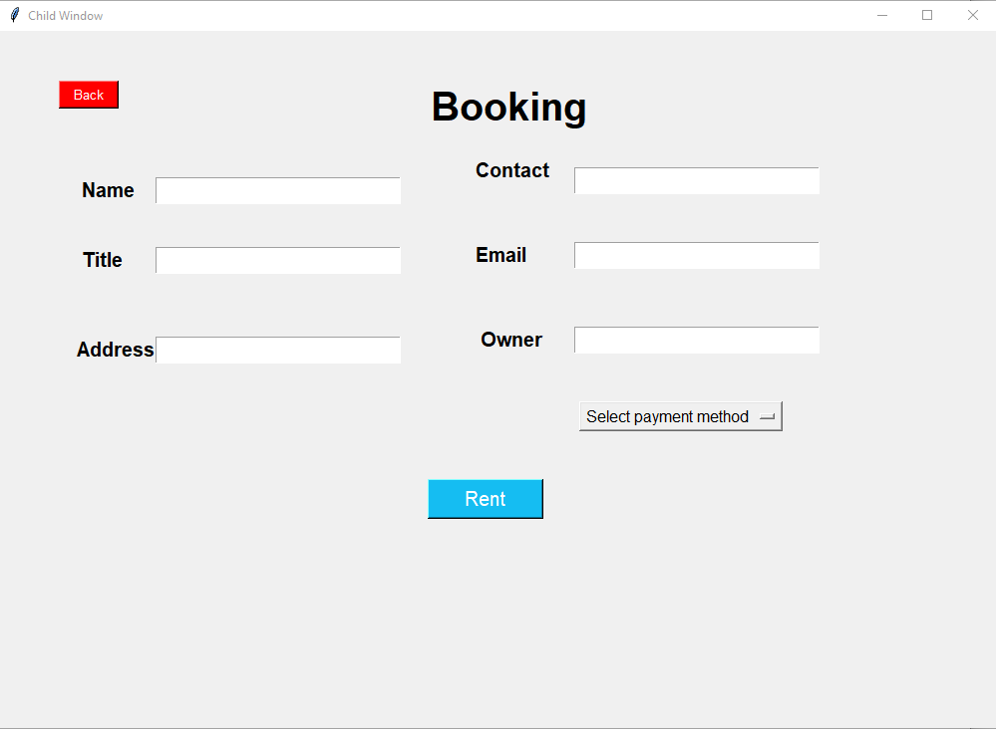
User Mode
13
After clicking Rent button

Slide 13
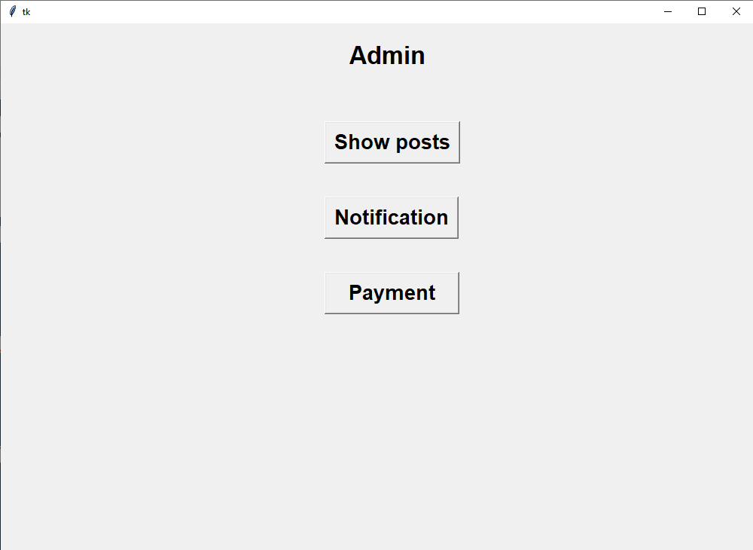
Admin Mode
14
Admin page

Slide 14
Admin Mode
15
Admin Showing posts

Slide 15
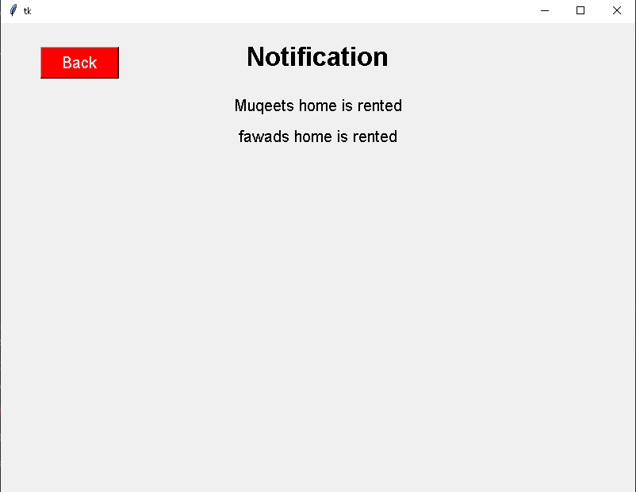
Admin Mode
16
Admin notifications

Slide 16
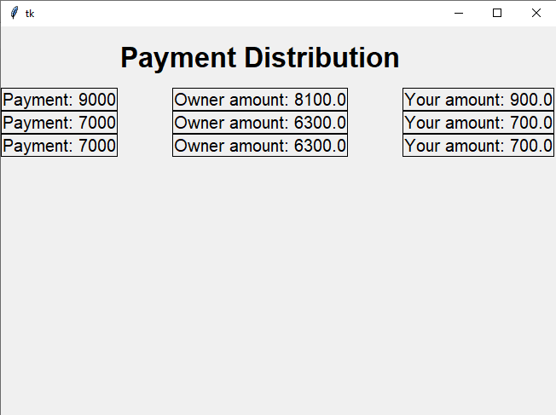
Admin Mode
17
Admin payment distribution

Slide 17
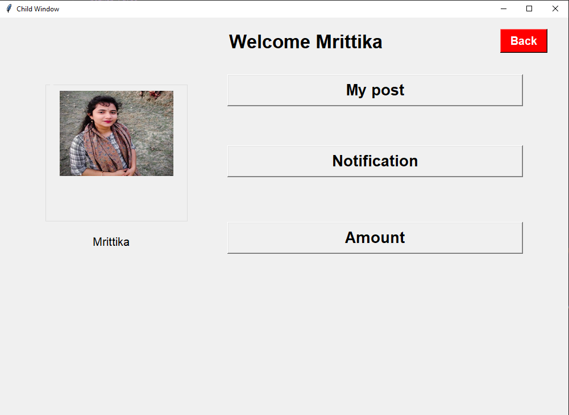
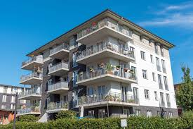
Owner Mode
Welcome uzain
Uzain
18
Owner profile after login

Slide 18
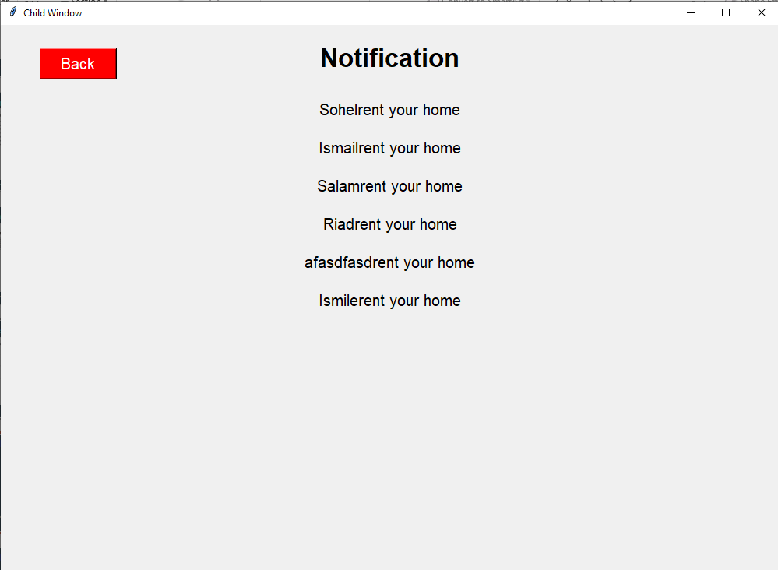
Owner mode
19
Owner notifications

Slide 19
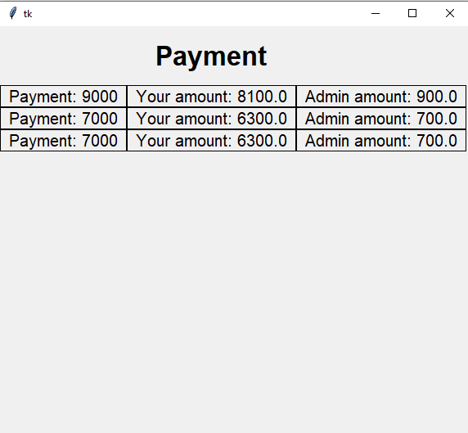
Owner mode
20
Owner payment distribution

Slide 20
Dependency :
Tkinter : Use tkinter module for user interface.
Sqlite3 : Depends on sqlite3.
Pycharm : Use pycharm as compiler.
21

Slide 21
Conclusion :
Python tkinter was new to us.
Faced some problem while maintaining owner and admins payment distribution.
Tried to make a better ER-Diagram and site tree.
A possibility of an update in the future.
22

Slide 22
Thanks!

